Slide 1
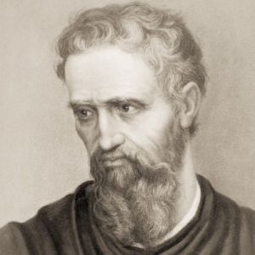
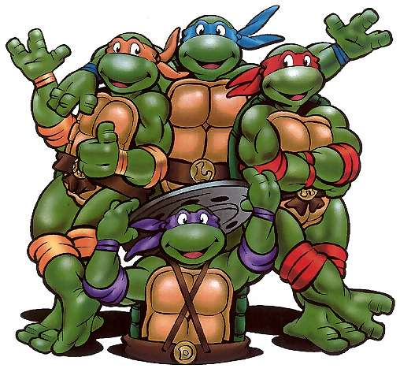
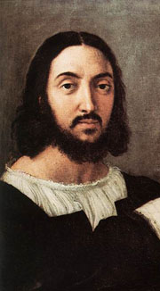
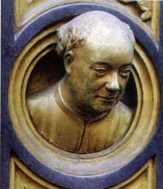
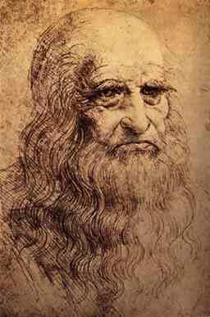
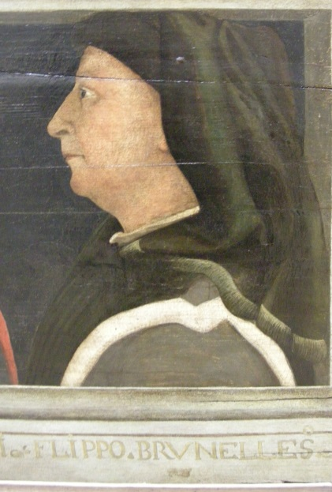
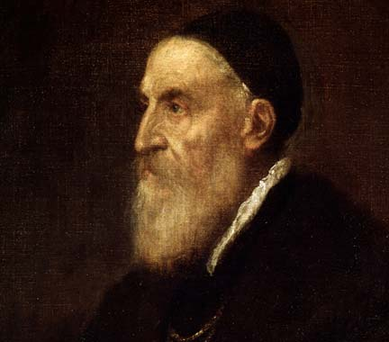
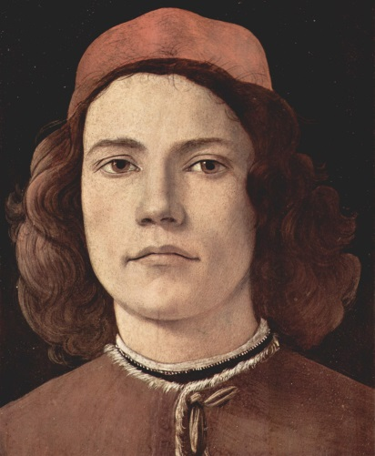
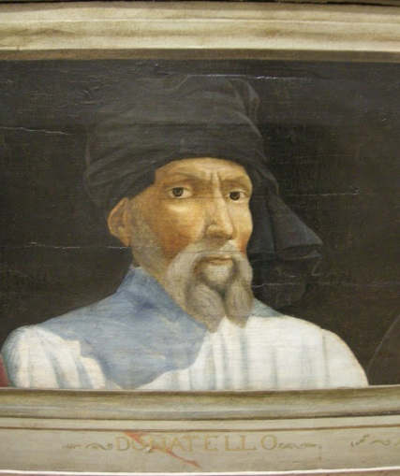
Artists of the Renaissance
Notes:
M. Was born in 1475 and died 1564.

Slide 2
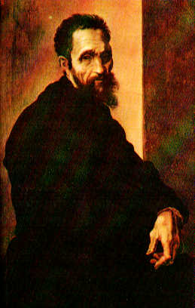
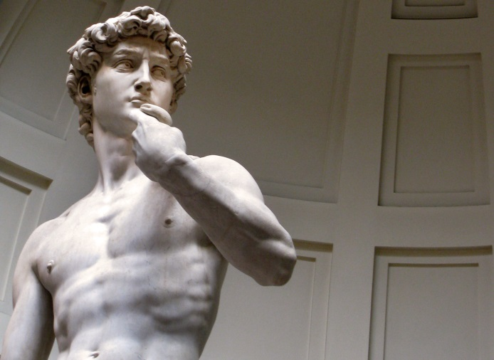
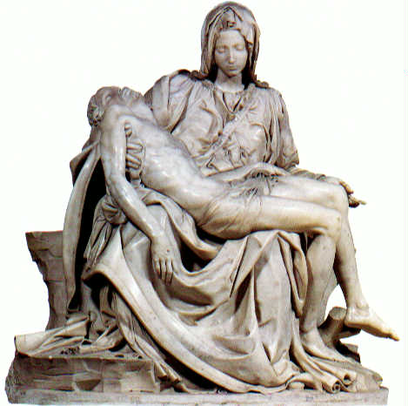
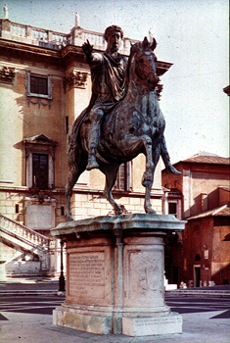
Michelangelo Buonarroti
“ The Inspired Genius of the Renaissance”
* Michelangelo (1475-1564) grew up in Florence where he became a master sculptor, painter, architect, poet, and engineer.
The David
“Guardian” of Florence
The Pieta, St. Peter’s Basilica in the Vatican City in Rome, Italy
Capitoline Hill
& Marcus
Aurelius
Notes:
M. Was born in 1475 and died 1564.

Slide 3
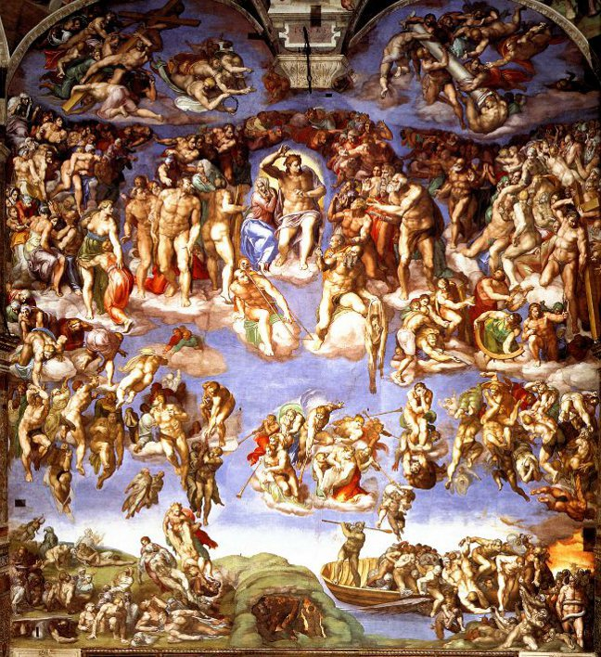
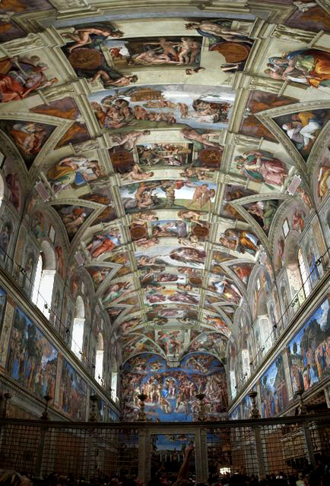
The Ceiling of the Sistine Chapel
The Last Judgment
The Creation of Adam

Slide 4
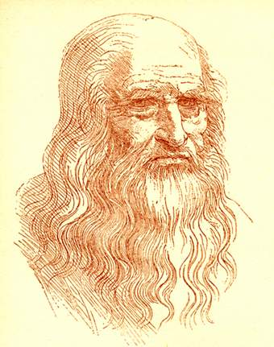
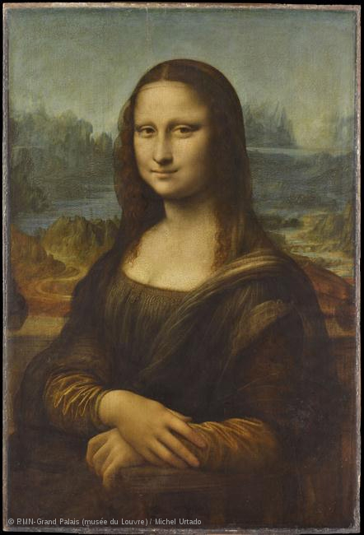
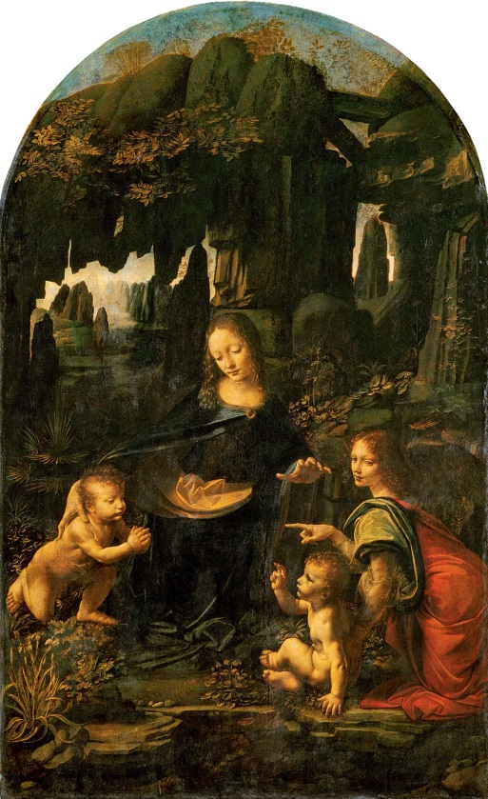
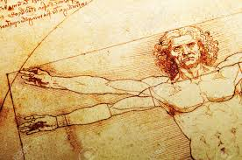
Leonardo da Vinci
Leonardo da Vinci (1452-1519) was a painter, architect, inventor, engineer, sculptor, and student of all things scientific.
Portrait of a Man in Red Chalk
Virgin of the Rocks
The Mona Lisa
The Vitruvian Man

Slide 5
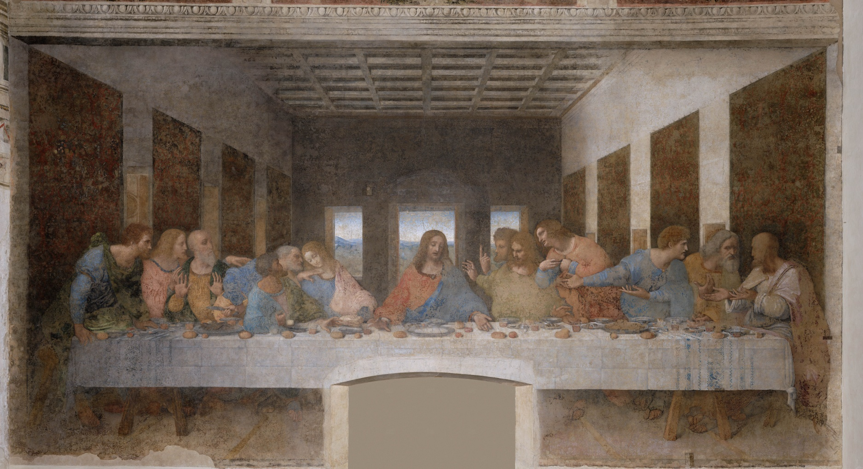
The Last Supper – Jesus and his 12 disciples

Slide 6
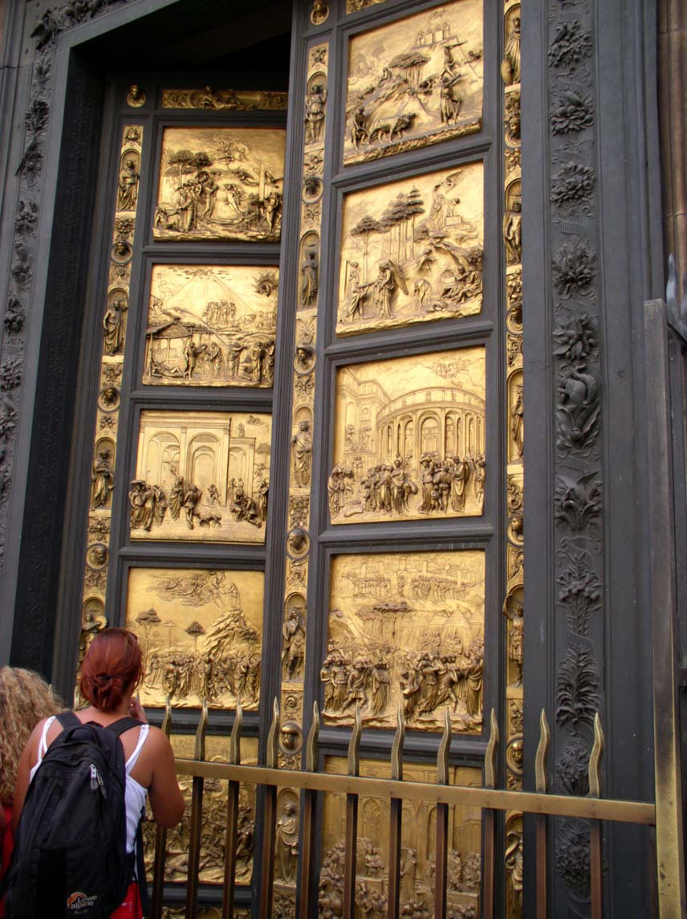
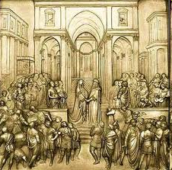
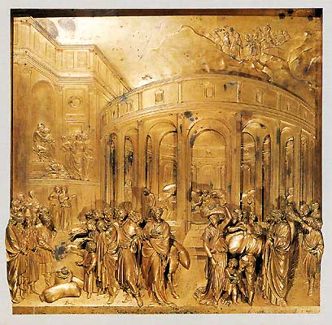
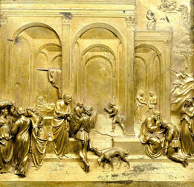
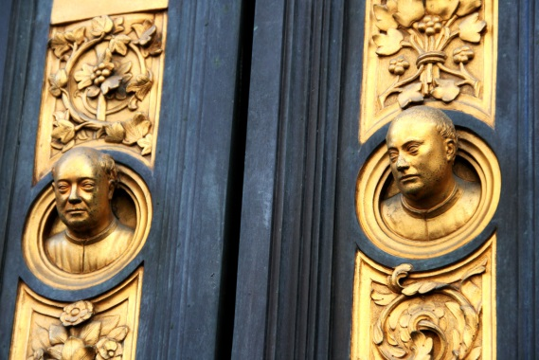
Lorenzo Ghiberti
Ghiberti (1378-1455) spent 22 years creating the doors to the Baptistery of the Cathedral in Florence (c. 1402-1424)

Slide 7
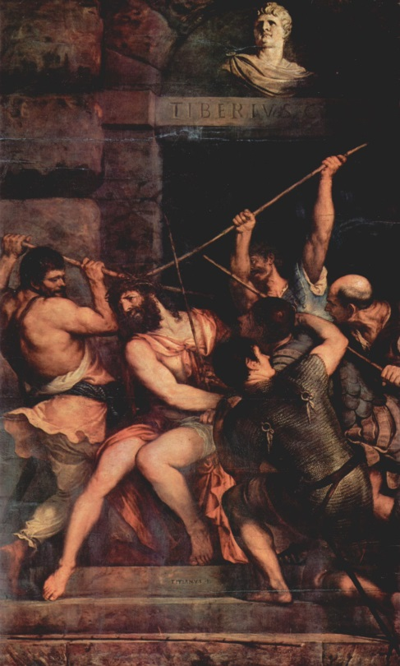
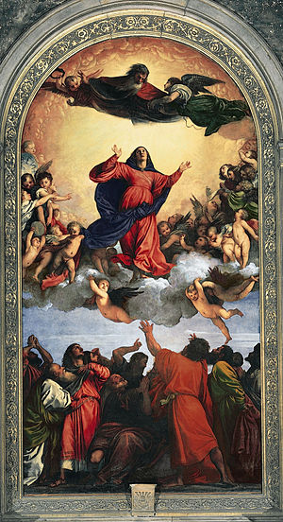
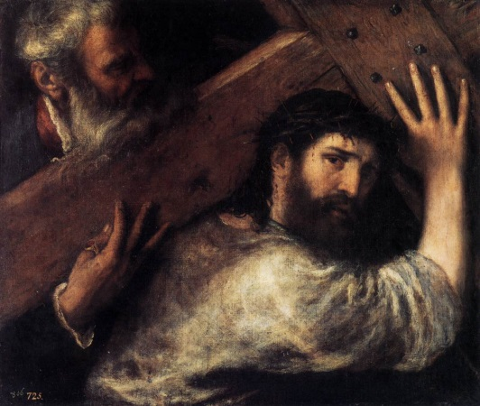
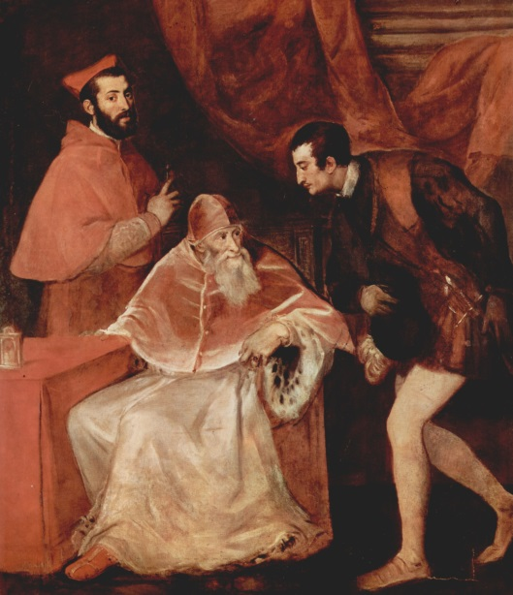
Titian
Tiziano Vecellio (c. 1488–1576), better known as Titian, was the greatest Venetian artist of the 16th century and created great works for leading members of royalty and the Catholic Church.
Christ Carrying the Cross
Pope Paul III & His Grandsons
The Crowning with Thorns
Assumption of the Virgin

Slide 8
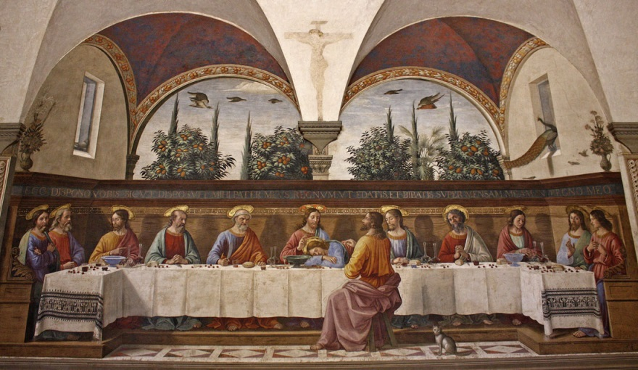
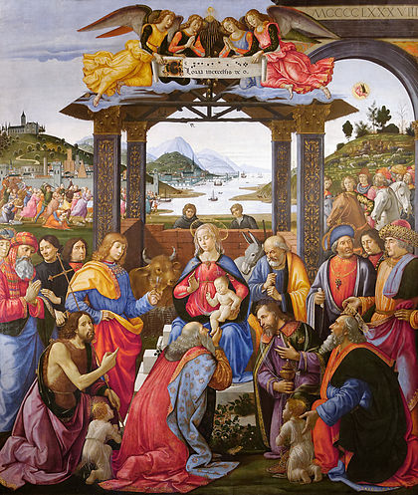
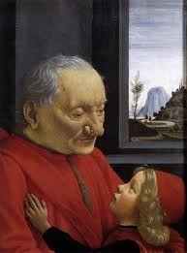
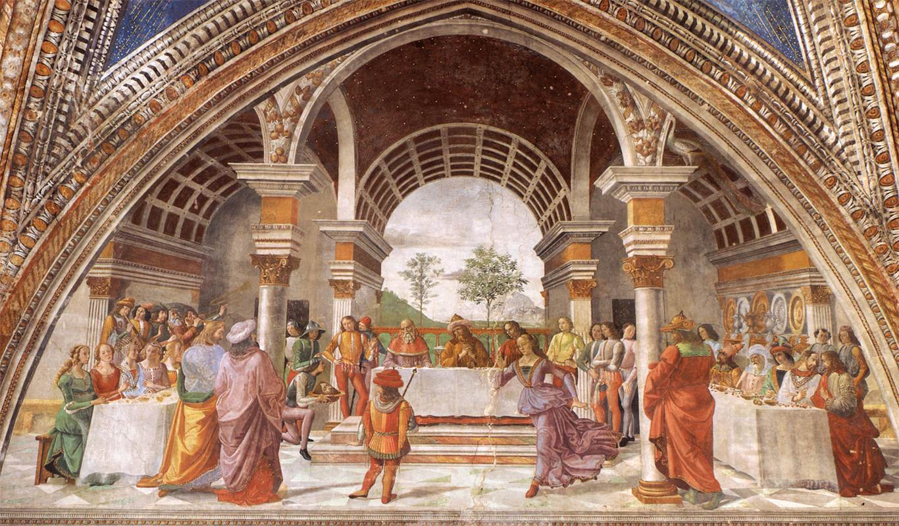
Ghirlandaio
Domenico Ghirlandaio (1449-1494) was an early Renaissance painter from Florence known for detailed frescoes on large wall surfaces.
The Last Supper
Adoration of the Magi
An Old Man and his Grandson
Herod's Banquet

